Slide 1
Human-Centered Artificial Intelligence (HCAI)
Fundamentals & Applications

Slide 2
Overview
Topics:
Recap of topics:
Extended Mind
Network-enabled cognition
Interaction
Lectures:
HCAI Fundamentals & Practices
HCAI Applications
Foundational; why does AI, or traditional HCI, add value?
How and where does AI add value?
Real-life examples explained

Slide 3
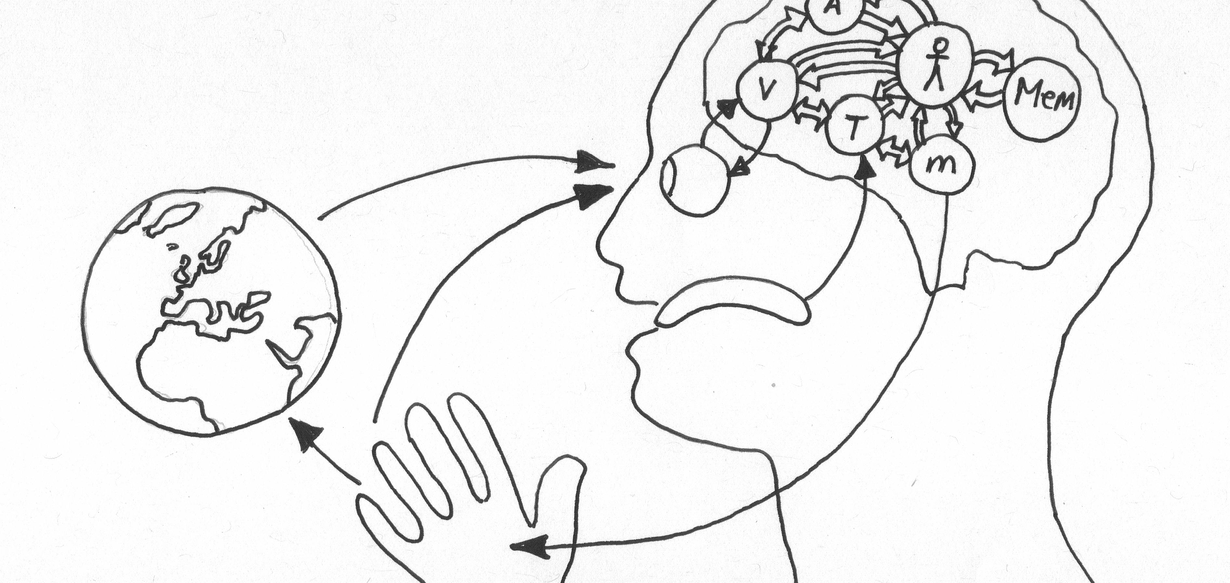
Extended Mind Theory
Objects in the external environment can be part of a cognitive process and in that way function as extensions of the mind itself.
Notes:
What does extended mind theory state? Or what is an extended mind?
[click to add definition]
Can you name some examples of mind extensions?
What is the difference between the mind and the consciousness/brain?
What is the value of Extended Mind Theory for Human Computer interaction?
What are the implications Extended Mind Theory for Human-centered Artificial Intelligence?

Slide 4
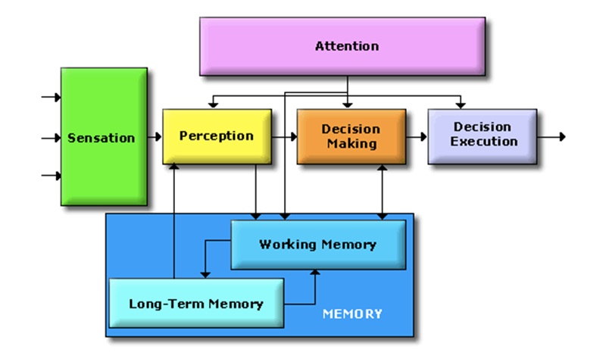
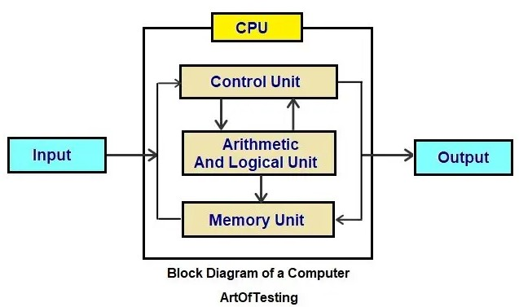
Computers: adding processing besides memory capacity to our ‘cognition’
Human Cognitive System
Computational System
Info/Controls
Info/Behaviour
Environment
/
Communication Medium
(e.g. Display, speakers)
Info/behaviour
Info/Controls

Slide 5
Network-Enabled Cognition Theory
The technological and informational elements of a large-scale information network can, under certain circumstances, constitute part of the material supervenience base for(/relationship between) an agent’s mental states and processes.
Notes:
What does Network-Enabled Cognition theory state?
[click to add definition]
Cognitive capacity; working memory is very limited (consicous 100 bits, unconsicious 100k bits) ; AI is only limited by the computation capacity available so it can be a great enrichment to our own intrensic cognitive capacity
Can you name some examples of network-enabled cognition?
What is the difference between the Extended Mind Theory and the network-enabled cognition?
What is the value of Network-Enabled Cognition for Human Computer interaction?
What are the implications of Network-Enabled Cognition for Human-centered Artificial Intelligence?

Slide 6
Computers: adding processing besides memory capacity to our ‘cognition’
Computational System(s)
Human Cognitive System
Human Cognitive System
?!?!
Info/Controls
Info/Behaviour
Info/Controls
Environment
/
Communication Medium(s)
Info/behaviour

Slide 7

Interaction
Communication or direct involvement with someone or something: a reciprocal action or influence
Notes:
What is interaction?
[click to add definition]
Why is interaction central to the mind?
Why is interaction fundamental to data exchanges?

Slide 8
Human-Centered Artificial Intelligence
Design discipline within artificial intelligence for designing applications that are reliable, safe, and trustworthy, and effectively serve people's needs.
Notes:
Machine learning (ML) is the science of helping computers discover patterns and relationships in data instead of being manually programmed. Machine or deep learining is a powerful tool for creating personalized and dynamic experiences, and it’s already driving everything from Netflix recommendations to autonomous cars. But as more and more experiences are built with ML, it’s clear that UX designers still have a lot to learn about how to make users feel in control of the technology, and not the other way round.
What is HCAI?
[Click to add definition]
How is HCAI distinct from human-computer interaction?
Essential, products which we perceive as intelligent come with certain assumptions: specifically that the user can anticipate what the product is going to do and that the product anticipates what the user want. In other words, users expect them to respond as quasi-human.

Slide 9
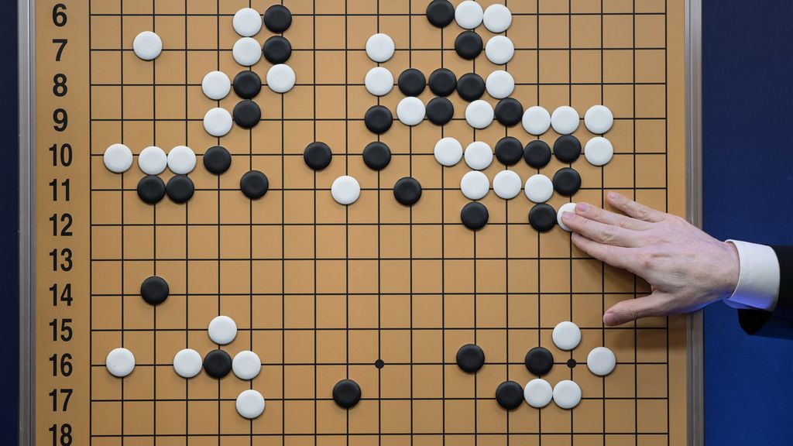
AI is already making people more creative
[14]
Superior artificial intelligence makes human go-players more creative
Superior?
Knowing an array of strategies is less effective against AI; it's knows them and these are usually algorithmic
Players become less systematic, less predictable, more novel, and more innovative
How this generalizes to high-order thinking skills is being actively researched

Slide 10
Human-Centered Artificial Intelligence
Fundamental & Practices

Slide 11
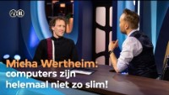
Anthropomorphism

Slide 12
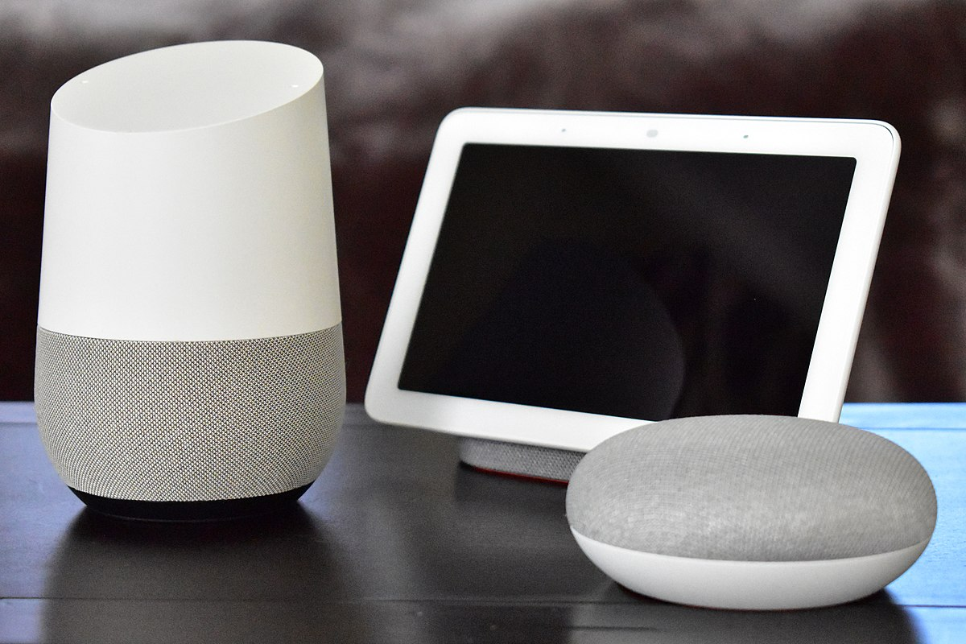
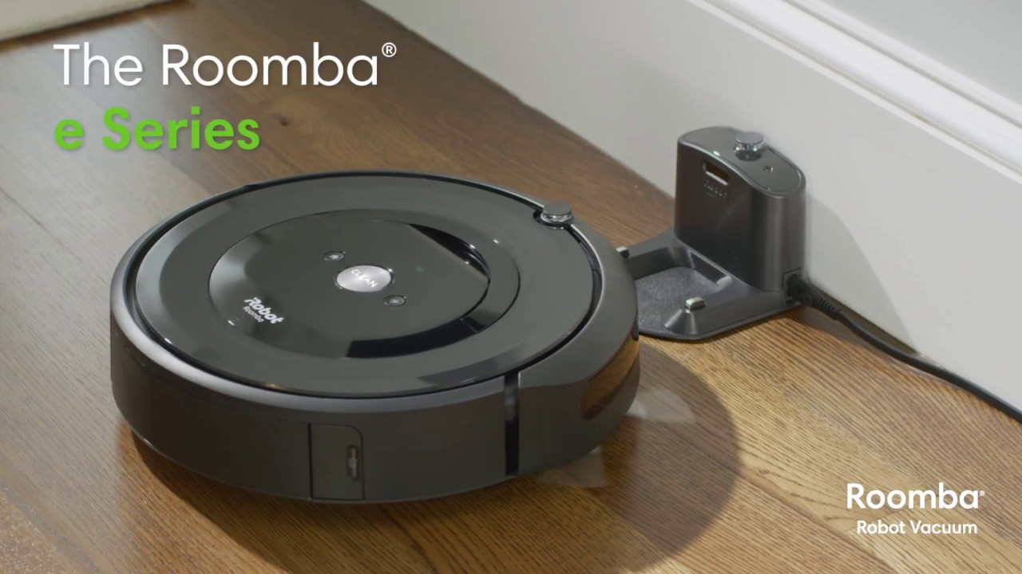
User-Centered AI
Perceiving AI
Context dependent; all experiences are, AI responds to the environment
AI is there to help you; like a side-kick, so in the eyes of a user AI:
can:
Self-learn;
Anticipate;
Respond;
Problem-solving ( or it simulate).
is:
Personal;
Familiar;
In motion;
Friendly;
Unobtrusive.

Slide 13
User-Centered AI
User needs
So to a user, AI is like a relationship: interaction and communication:
The AI should anticipate what the user wants and the user will anticipates what the AI will do
HCAI is not about being futuristic but about adding value; being helpful:
contributing to network-enabled cognition
and therefore making our lives easier

Slide 14


User-Centered AI
User needs
Intuitive design
Easy to explain
Easy to understand and to connect the dots
Sci-fi often violates these principles, like Minority Report
How to explain this to a user?
Notes:
Just imagine of how crazy it’d be to actually explain something like the UI in Minority Report to users: Here, just extend your arm out, wait two seconds, grasp at thin air, then fling wildly to the right while rotating your hand counter-clockwise. It’s easy! Almost every sci-fi UI is guilty of something similar; as if the complexity of an interaction model needs to keep pace with the complexity of the system it’s driving.

Slide 15
User-Centered AI
User needs
Manage user expectations: AI cannot do everything but the user will often expect futristic results; emphasize how and where it can help; not that it is AI driven (unless you’re selling the product to investors :p)
Which information does the user need and in what form? Full disclosure isn’t always helpful; limeted might be more useful: e.g. 85% prediction confidence isn’t neccesarily reassuring to a user
Trust and self-efficacy are key: the users needs to be able to trust the application with their personal data and feel in control of what happens with it

Slide 16

HCAI Fundamentals
AI isn’t going to solve your problems for you
Hype causes unrealistic expectations;
Meaningful problems are foundational; otherwise, AI might be overkill
Finding a meaningful problem still requires you to do the research and interpretation
Design thinking and the PAIR guidebook are great tool to find the right problems to solve!
What problem am I trying to solve?

Slide 17
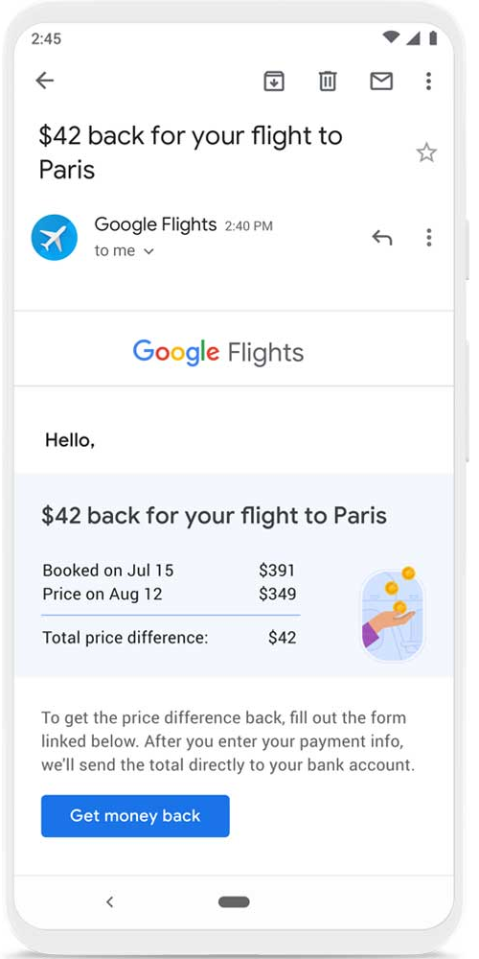
HCAI Fundamentals
Problems…
Just as any other thing we create, the important thing is that what we create adds value and is therefore useful
Therefore, we first need to identify the problem
This can be a very clear problem → google flights
Or a problem people weren’t aware of; something that makes their live easier, give a competitive edge → cell phones
The problem consists of a need and a behavioral pattern
Then, we can identify what would be valuable to solve that problem
What do people need?
What are other important factors? E.g. Weather, market, mental or biological states like energy level etc.

Slide 18
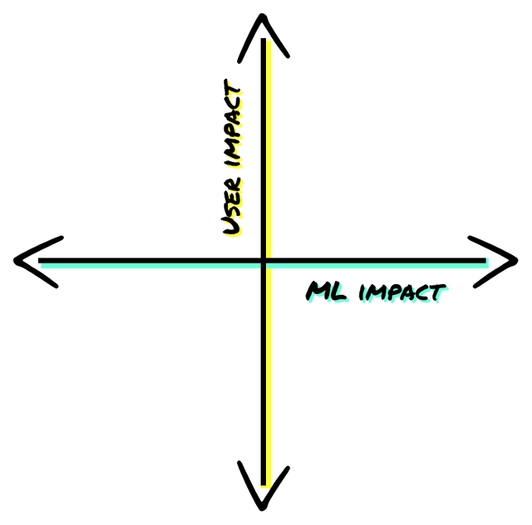
HCAI Fundamentals
Not every problem can be solved meaningfully using ML
Ask yourself whether an ML solution actually adds a meaningful contribution
Sometimes a heuristic AI can work just as well or better, for example:
Regression model, numerical model etc.
State machine
Sometimes an AI isn’t needed in the first place, not even a heuristic one like a reactive state machine
Does implementing an AI actually add unique value? Is there a faster route?

Slide 19
HCAI Fundamentals
Not every problem can be solved meaningfully using ML
How do you find out? Ask yourself:
How would you describe the way a theoretical human "expert" might perform the task today?
If your human expert were to perform this task, how would you respond to them so they improved for the next time?
If a human expert were to perform this task, what assumptions would the user want them to make?

Slide 20
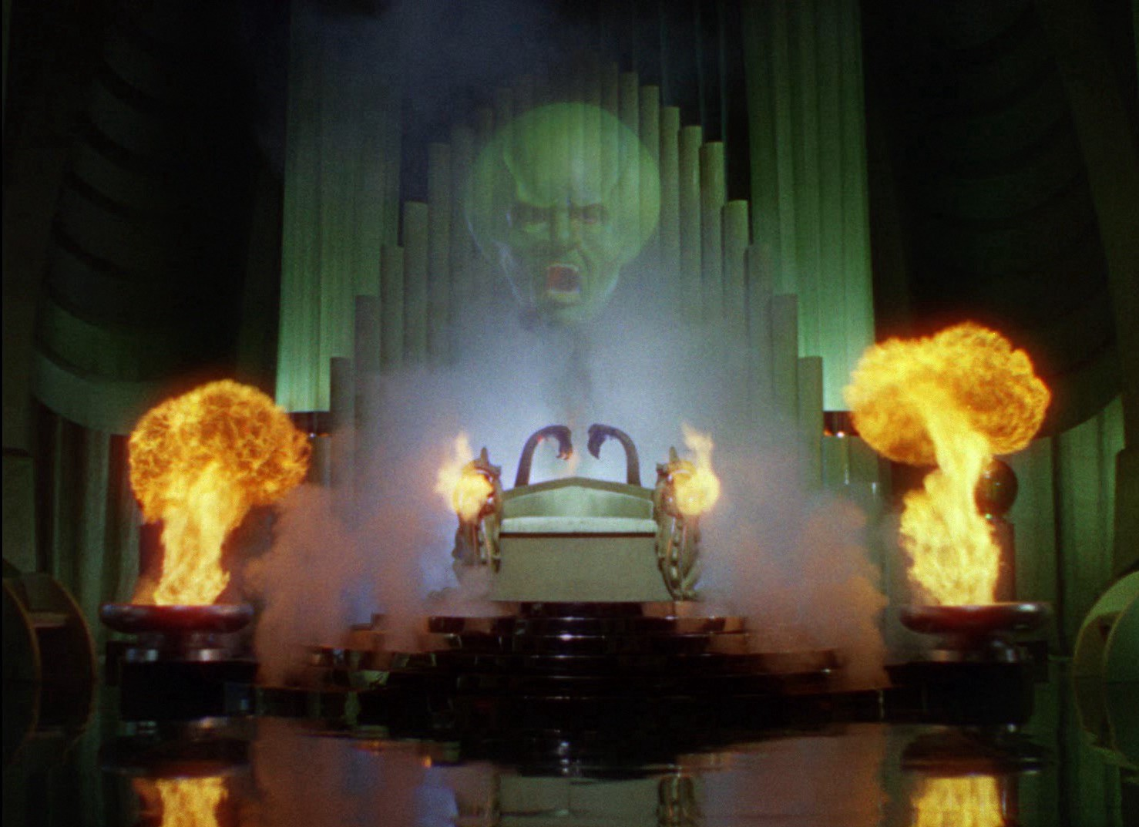
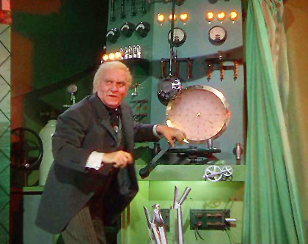
HCAI Fundamentals
Prototype your AI: Fake it
Users will expect that an AI anticipate what it should do → how it should respond to the user
Essentially, people expect it to respond like a (rudimentary) human; ‘intelligently’
Methods:
Interview: how did conventional intelligent agents (usually humans) help the user? → Identify good features & needs (status quo)
Wizzard of Oz Studies: great to test features & actual needs (test projected needs); especially to mimic AI features

Slide 21

Next up: design for continuous learning!
Fundamentals of HCAI → Great article; key inspiration for this lecture
Doing something with image labelling? → Good article to read
Doing something with recommender systems & Teachable Machine interfaces → good article to read

Slide 22
Human-Centered Artificial Intelligence
Fundamental & Practices: Continuous learning/planning for co-learning and adaptation

Slide 23




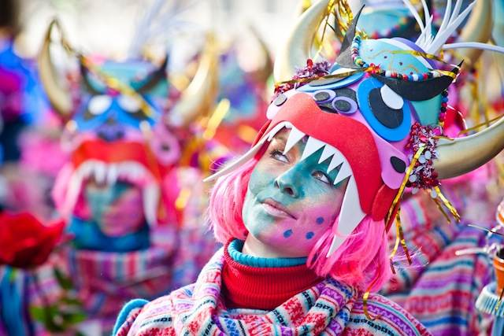
HCAI Fundamentals
Plan for co-learning and adaptation
ML systems evolve over time!
Especially recommender systems
Does you Instagram/tik-tok feed look the same now as it did 1 year ago?
People change and your AI should change with them; it’s like a good relationship where people change together: they keep growing together
Other examples?
Disney
Carnaval

Slide 24
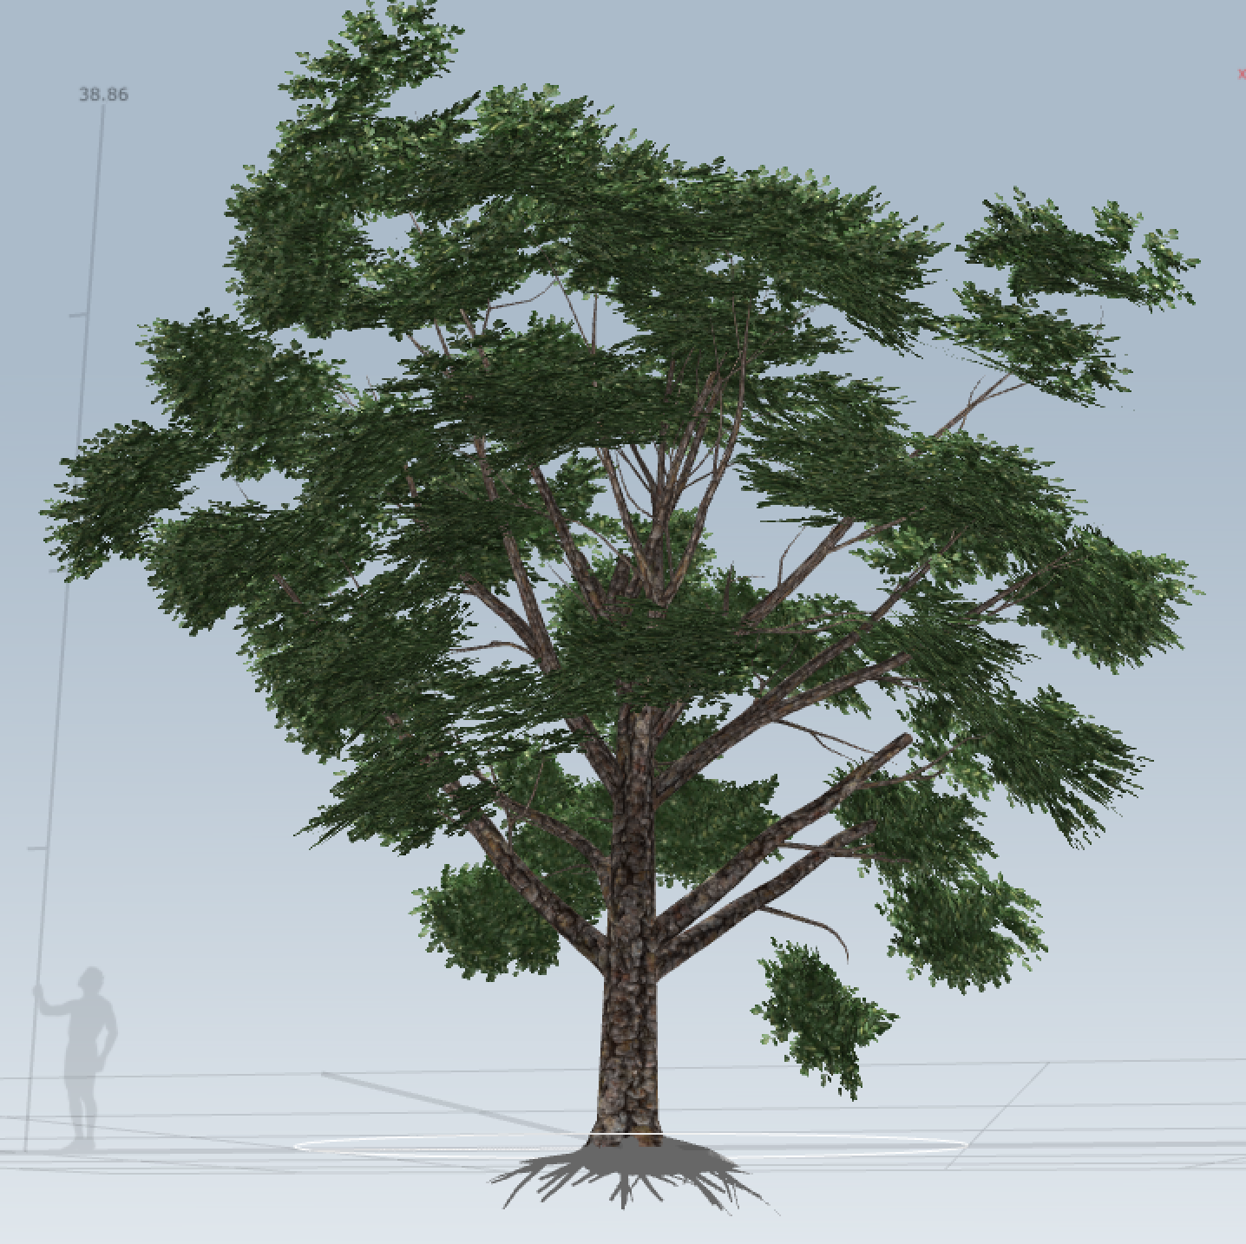
HCAI Fundamentals
Plan for co-learning and adaptation
Longitudinal effects?
Often looks at pictures of trees
High-touch/Strong effects?
Fruit tree obsession atm
Broad-Reach effects?
People who look at trees often enjoy advertisements about nature
Allow for user feedback
User can act as labelling agent
What else?
Notes:
Every facet of ML is fueled and mediated by human judgement; from the idea to develop a model in the first place, to the sources of data chosen to train from, to the sample data itself and the methods and labels used to describe it, all the way to the success criteria for the aforementioned wrongness and rightness. Suffice to say, the UX axiom “you are not the user” is more important than ever.

Slide 25
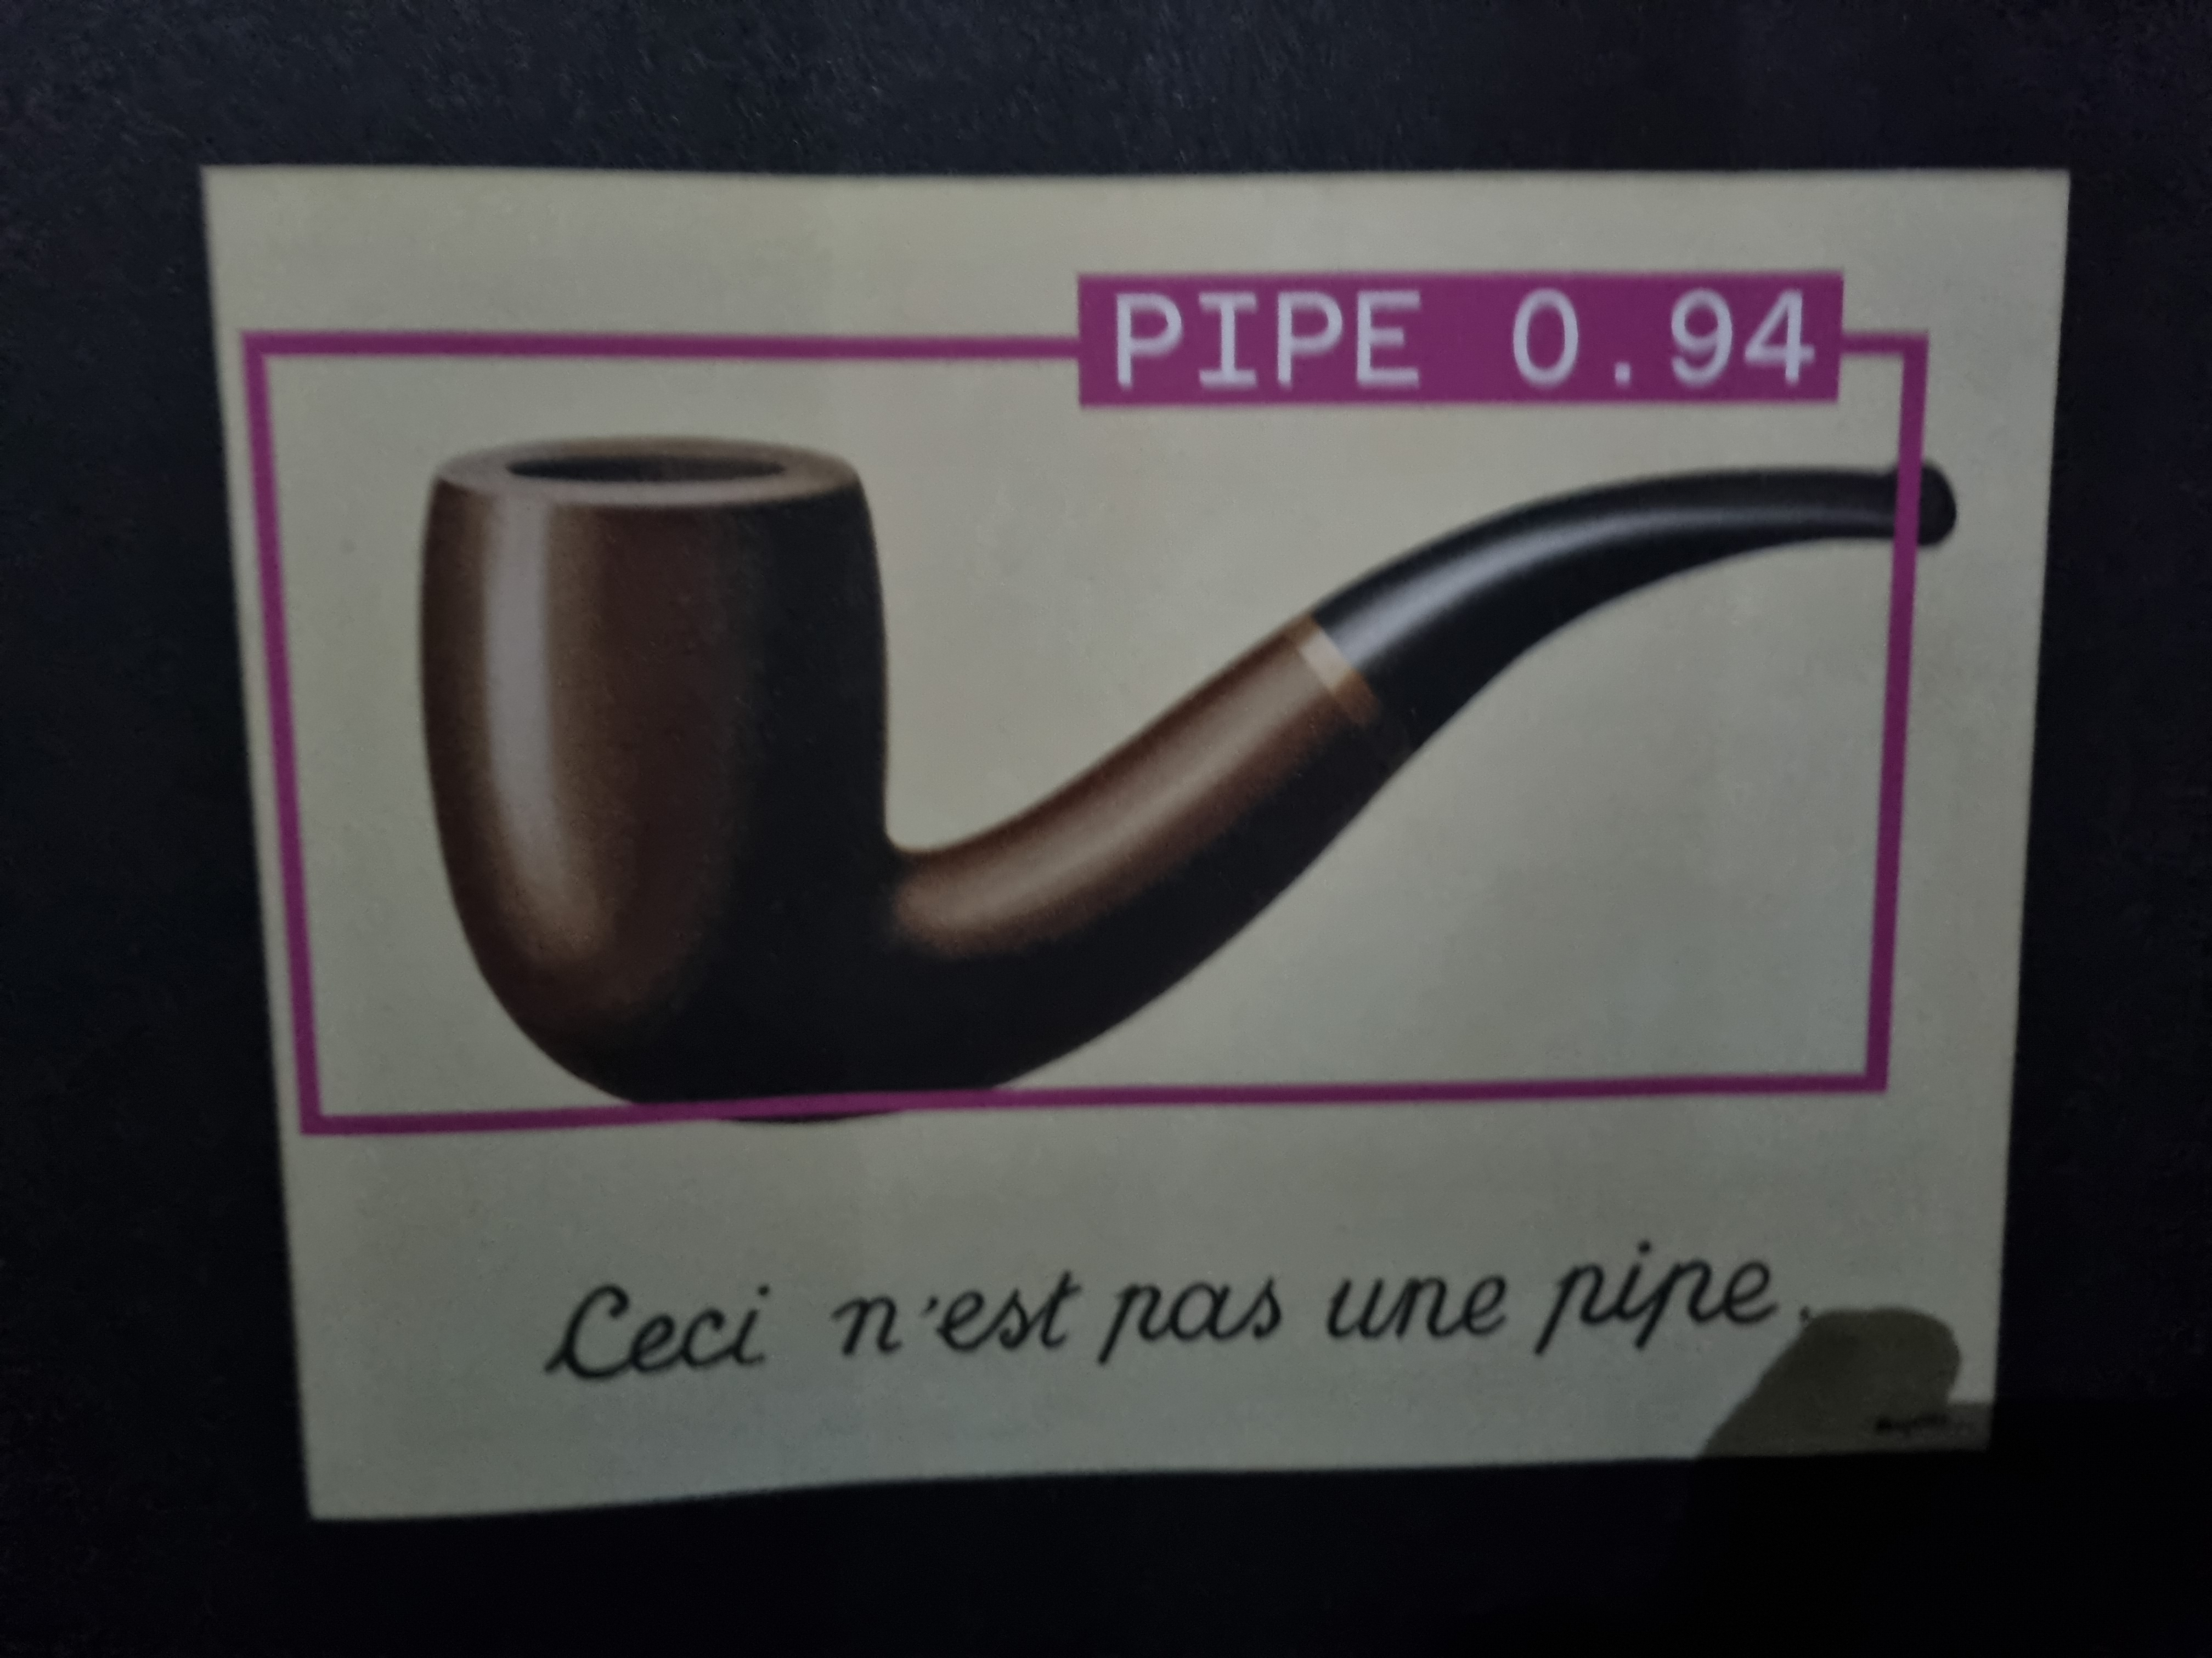

HCAI Fundamentals
Teach your algorithm, using the right labels!
Supervised learning? Then this is vital!
With ML there is only so much we can specify; the AI will classify objects itself
Adverse to being heuristically assigned
How can we do this?
Controlling dataset characteristics (size, quality etc.)
Controlling the output (share confidence level, queue for further processing)
Always ask yourself:
Is the model/algorithm predicting something it’s trained to predict?

Slide 26

HCAI Fundamentals
Teach your algorithm, using the right labels!
How can we do this?
Make the right assumptions:
“for ________ users in ________ situations, we assume they’ll prefer ________ and not ________.”
Then get your assumptions into a hacky prototype
Get domain experts on board
Human labellers
Some time ago I met a person on a party who labels and corrects chatbots replies for Pathe; essentially, she and her colleagues were training their AI to take over (easy parts of) their work
But… people change and the AI needs to change with them… So, whether they will (ever/soon) be replaced is questionable
→ Also risks....

Slide 27
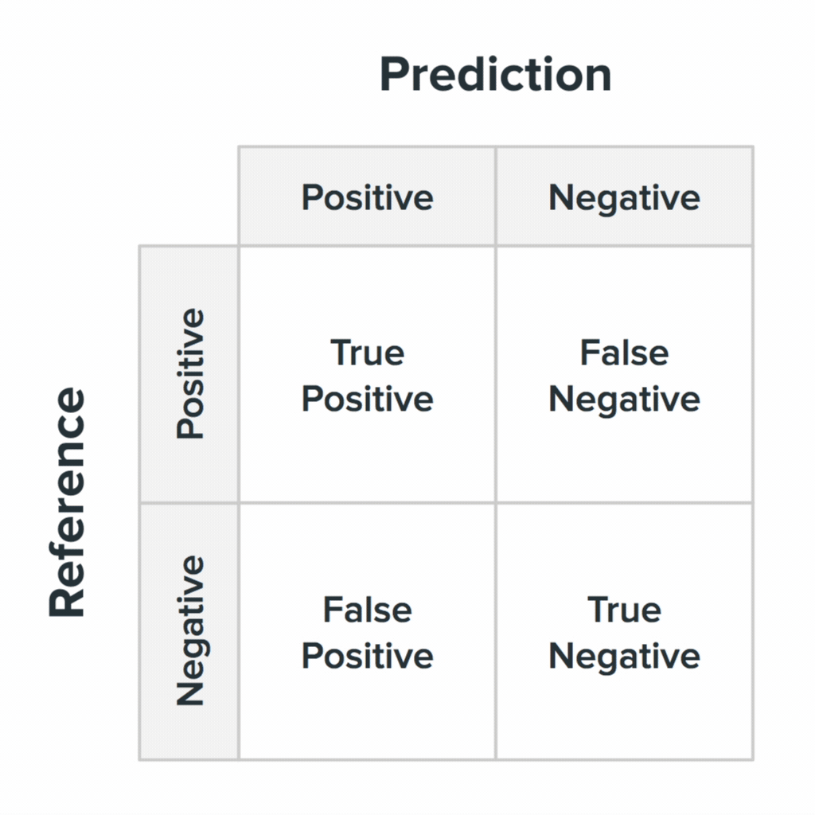
HCAI Fundamentals
Weigh the costs of false positives and false negatives
Confusion matrices again!
What is the cost of a false positive?
What is the cost of a false negative?
Where do you priorities lie?
Very important! But, already covered in other parts of this block so let’s not dive into it here!
But, be aware that you do need to think about this when designing!

Slide 28
So, is this all you need to know?
No. → R.I.P. us
AI and digital technology is advancing rapidly
Some things we just don’t know how to do yet
You don’t learn good design by just studying theory; but it helps
Design isn’t about knowing; about fundamental knowledge
Design is about inferences; connecting the dots: both for the user and for the designer
And keeping the central value of whatever solution you have in mind
That means:
Trying out ideas
Testing, prototyping
Failing and learn
Iteration and implementation

Slide 29
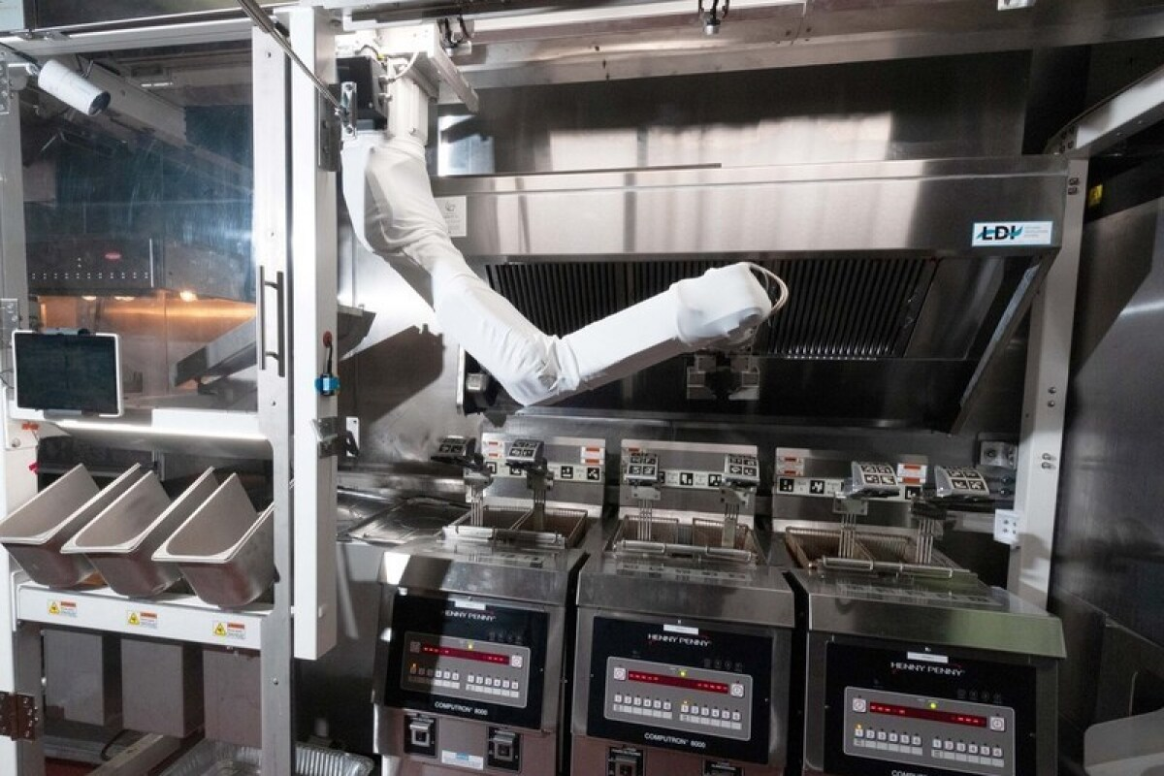
HCAI Fundamentals
HCAI (and ML) is still more of a craft (like cooking!)
There is not set way to solve a problem
There are recipes
But…
A good recipe does not make a good cook
Burger Flippy 2 on the right; apparently Flippy 1 didn’t make it into White Castle
Practice and insight into the process are fundamental; and thereby come intuition and iteration

Slide 30
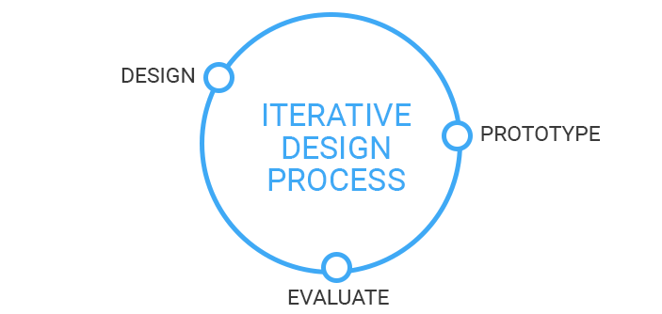

Slide 31
HCAI: Applications
A brief overview of the possibilities and what’s out there…

Slide 32

Crowd-Generated Data
3 Cool
Papers
On topic
Opportunities
Let humans do things that computers will never be able to do. → or not yet
Let humans lay the foundations so that computers can learn to do things.
Let humans do tasks to allow them to distinguish themselves from computers.
Let computers and humans work in symbiosis to solve certain tasks.
Also referred to as Crowd-Sourcing

Slide 33
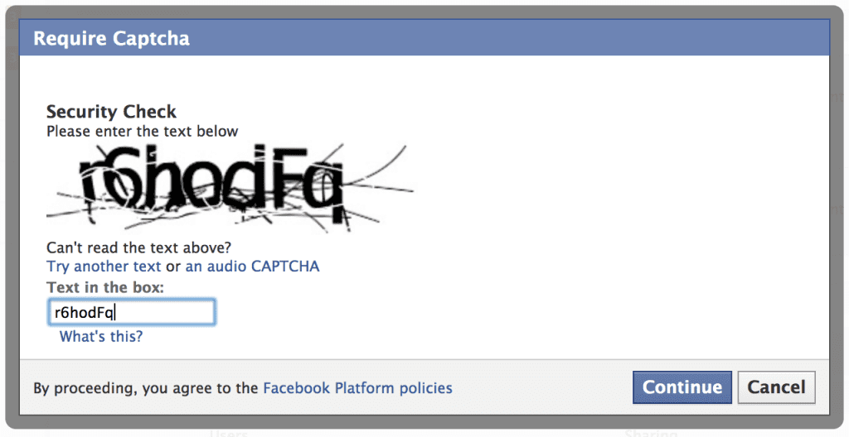
Crowd-Generated Data
CAPTCHA
Problem: Software algorithms can be used to take advantage of many internet services
Polls
Registering E-mail addresses
Buying tickets
…

Slide 34
Crowd-Generated Data
CAPTCHA
Solution: Completely Automated Public Turing test to tell Computers and Humans Apart
Based on the fundamental idea from cryptography: a computer can probably crack this code, but based on what we know right now, it would take a very long time to do so.
Take tasks that AI is currently not very good at → Give it to humans
A CAPTCHA is a cryptographic protocol whose underlying hardness is based on AI problem.
Curious? → Link to Paper (Von Ahn et al., 2000)

Slide 35

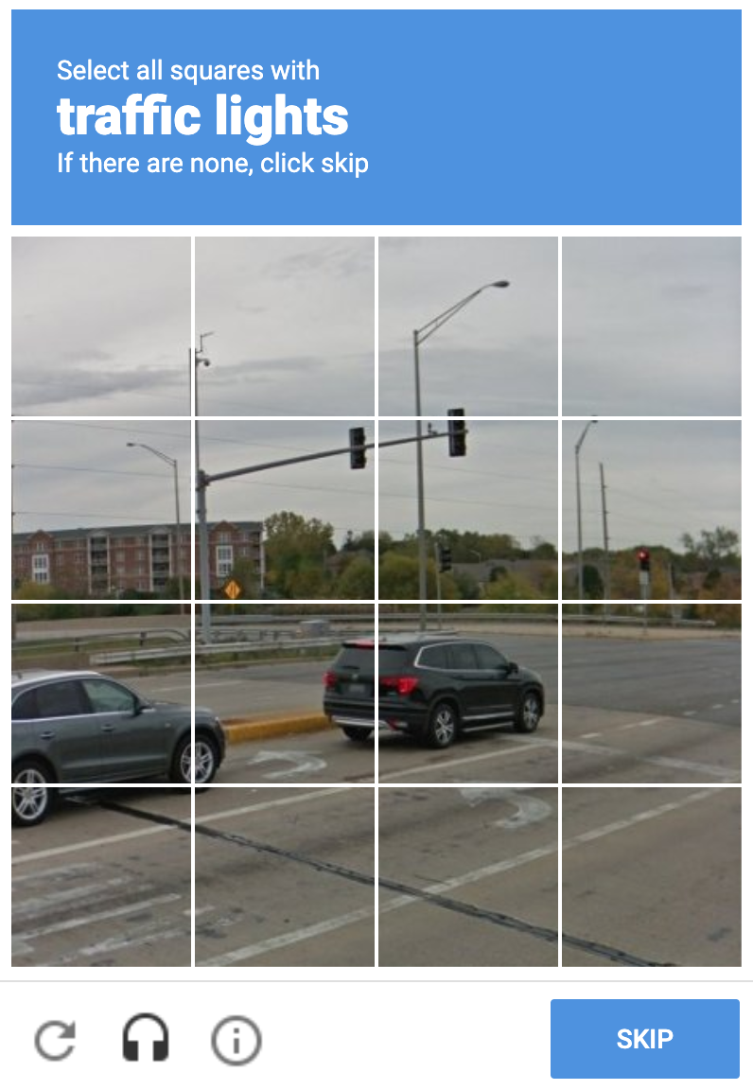
Crowd-Generated Data
reCAPTCHA
Acquired by Google in 2009
“A free service that protects your website from spam and abuse. reCAPTCHA uses an advanced risk analysis engine and adaptive CAPTCHAs to keep automated software from engaging in abusive activities on your site. It does this while letting your valid users pass through with ease.”
Designed to distinguish humans from bots and at the same time provide useful tasks:
Labelling data
Identifying problems for the AI
How? You get one correctly labelled image and one new one (or “unsaturated” one)

Slide 36
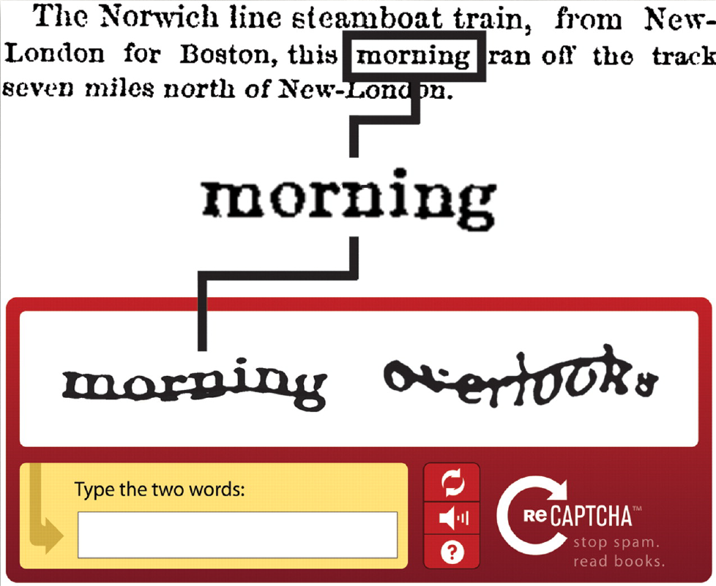
Crowd-Generated Data
reCAPTCHA
First application: recognition of (difficult, old, …) texts that Optional Character Recognition software is really bad for with regards to processing it
Has been used to digitize Google Books and complete New-York Times archive

Slide 37
Crowd-Generated Data
reCAPTCHA
Why two words?
ReCAPTCHA already knows the answer to one of the words
If you type that word correctly, it assumes you are human
Some confidence that you also typed the second word correctly
Combine with answers from other users
If a large proportion of participants agree on what the word is, we can assume the recognition is correct.

Slide 38
Crowd-Generated Data
reCAPTCHA
Conversion
ReCAPTCHA is freely available for websites who need a CAPTCHA system to protect their services from abuse
→Free security service
Google can use the output for their own products or it can use the service to do word recognition for other organizations
Free data quality check; label generation
Money making machine

Slide 39
Crowd-Generated Data
reCAPTCHA
In 2011
350 000 sites were using ReCAPTCHA
About 100 million words were digitized per day
Equivalent to about 2.5 million books per year
750 million people had helped to recognize at least one word
Source: Massive-scale online collaboration | Luis von Ahn

Slide 40

Crowd-Generated Data
Games With A Purpose (GWAP)
“Trading entertainment for labour“
Applications:
Labeling images
Transcribing texts
Common sense or human experience based activities
Motivate people through entertainment rather than an interest in solving computation problems.

Slide 41
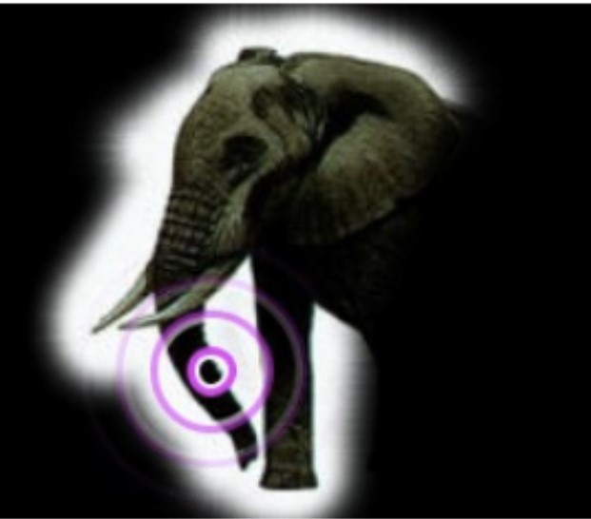
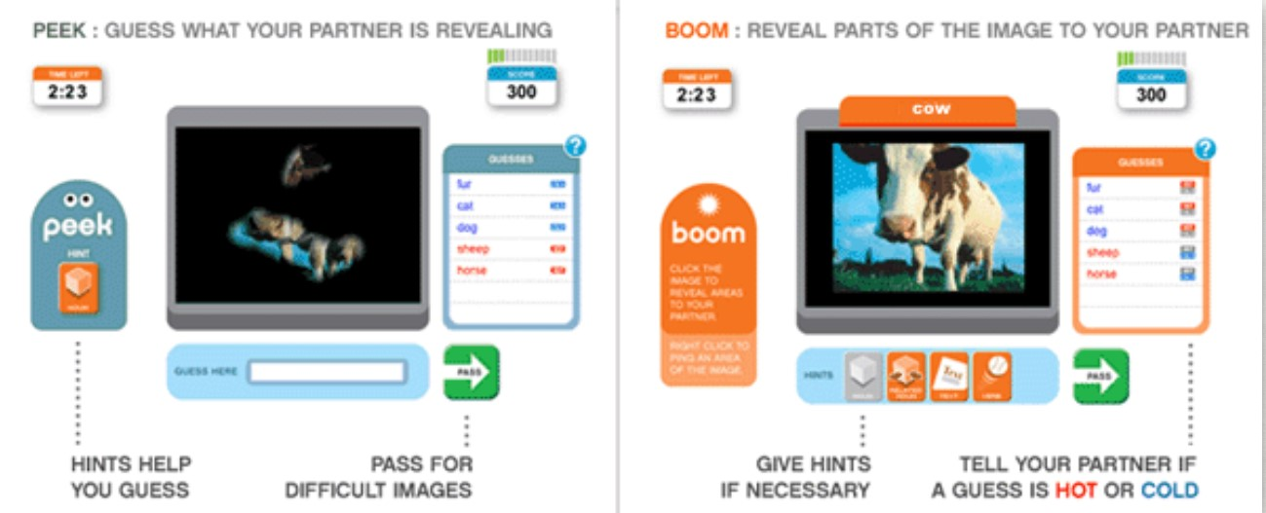
Crowd-Generated Data
PEEKABOOM GAME: Object Detection
Problem: to make computer vision work, you need to train algorithms to correctly predict which parts of an image correspond to specific objects, faces, etc.
Curious? → Link To Paper
Notes:
Goals:
To know which images are in the picture;
To know which pixels belong to which image
Two players: Peek and Boom
Peek initially sees nothing
Boom gets an image that is labelled
Must make Peek guess the word as quickly as possible
Boom clicks on a small circular area
Peeks sees small areas revealed
Peek tries to guess the word
By knowing which areas Boom clicks on, we know which area of the picture correspond to certain words
By knowing when Peek guesses correctly, we know what are the most “salient” parts of the image

Slide 42

AI Algorithm Implementation
Teachable Machines: Super fun way to experiment with computer vision :D
Link To Webpage
Maybe useful for prototyping…

Slide 43
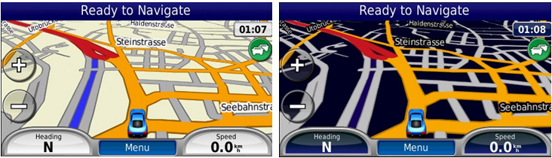
Adaptive Interfaces
“An adaptive user interface (also known as AUI) is a user interface (UI) which adapts, that is changes, its layout and elements to the needs of the user or context and is similarly alterable by each user.”
Feedback; let the user know it’s responding to input → Mostly military or transport
Not important now: but know that it’s there in ML-flavour as well → Also no access, rip

Slide 44

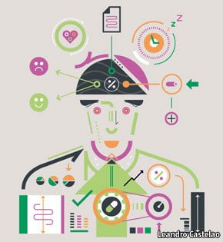

Quantified-Self
Tracking data about yourself
Link to paper if interested

Slide 45
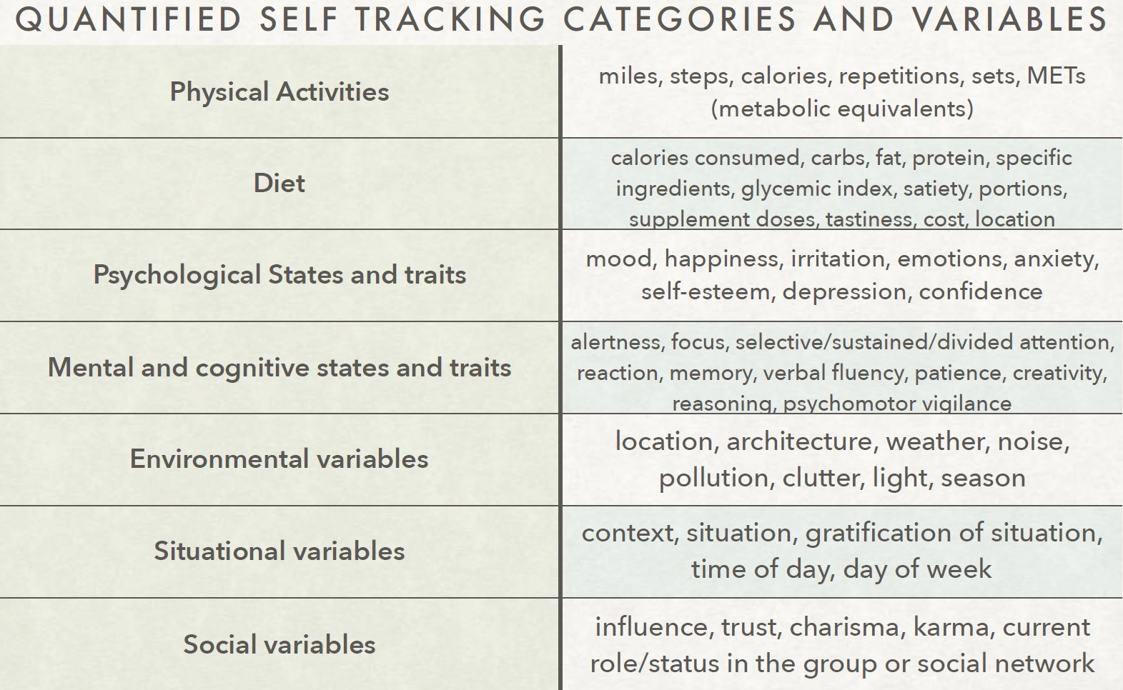
Link to paper for further reading

Slide 46

Announcements
After the lunch: Wizzard of Oz Experiment meets Paper Prototyping
Instructions on Github, materials are arranged.
Presentation Consults with Bert
30 minute time-slots
20 min ~ presentation, 10 min feedback ~ ; like actual presentation
Week 9
Tuesday, 13:00 – 17:00 (Preliminary times)
Thursday, 9:00 – 17:00 (with a break around lunchtime - Preliminary times)
On-campus preferred, otherwise online. (LIMITED SPACES!!!)
Designing for blind or deaf people? Unconventional interaction → Come find me in Datalab for feedback and tecniques

Slide 47
Questions?

